Slide 1
Seq2Seq with Attention

Slide 2
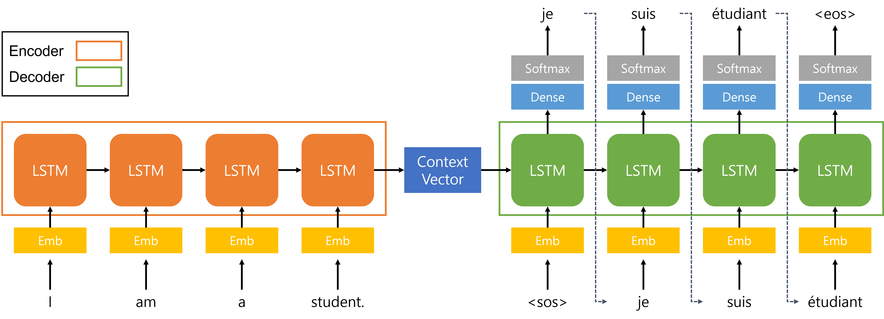
Architecture of seq2seq
Problem : Bottle Neck
?

Slide 3






Problem Of seq2seq
seq2seq
with attention
Axxx…
Bxxx…
Cxxx…
Dxxx…
Exxx…

Slide 4
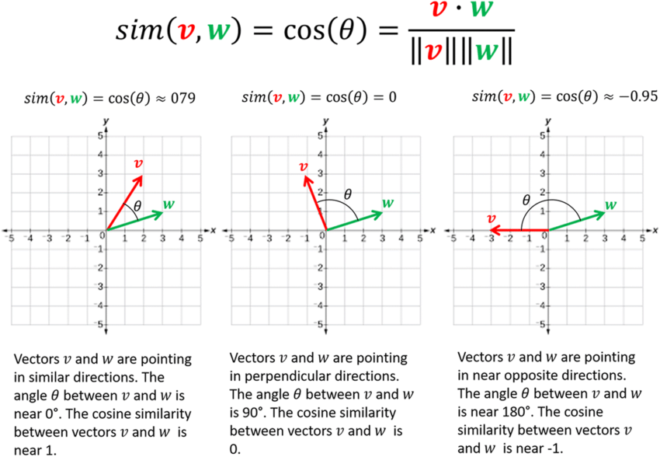
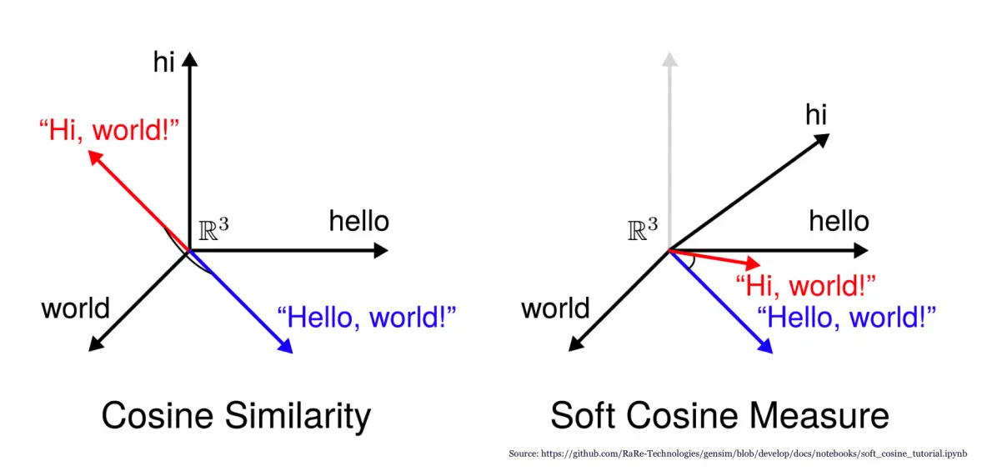
Dot Product & Cosine Similarity
※ 두 벡터 간의 내적이 클 수록 θ가 작고 유사도가 크다

Slide 5

Weighted Sum
× 0.8 +
× 0.1 +
× 0.1
× 0.8
× 0.1
× 0.1
× 0.1 +
× 0.8 +
× 0.1
× 0.4 +
× 0.0 +
× 0.6
※ weigh는 항상 양수이며, 모든 weight의 합은 1이다

Slide 6
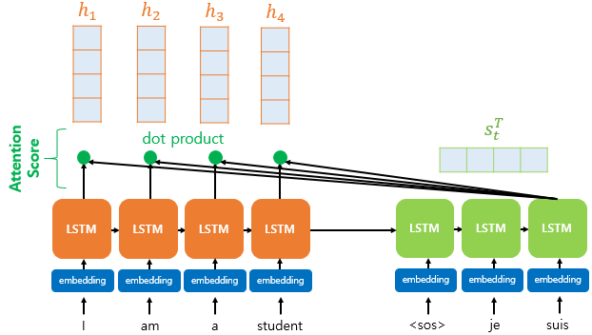
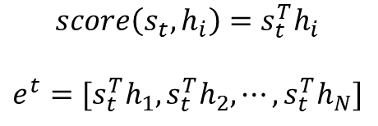

Step.1 – Evaluate Attention Score
$e^{t}$=[2.4, 3.6, -1.7, 0.5]
$$score\left(s_{t},h_{i}\right)=s_{t}^{T}h_{i}$$
$$e^{t}=[s_{t}^{T}h_{1},s_{t}^{T}h_{2},⋯,s_{t}^{T}h_{N}]$$

Slide 7
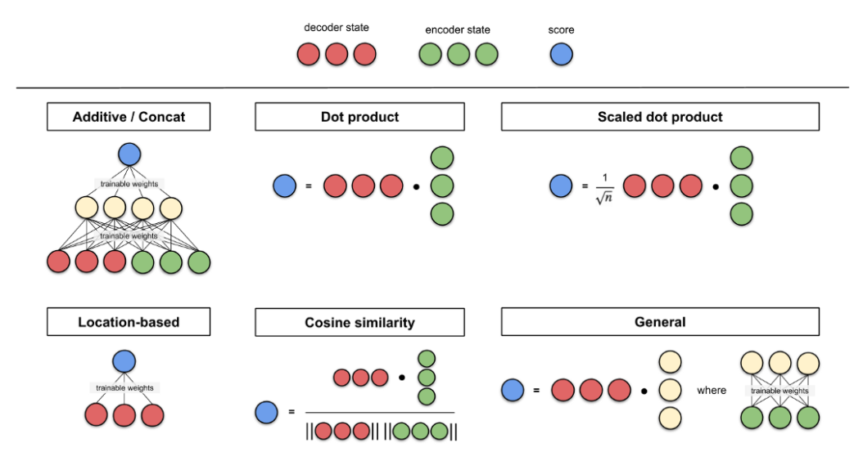
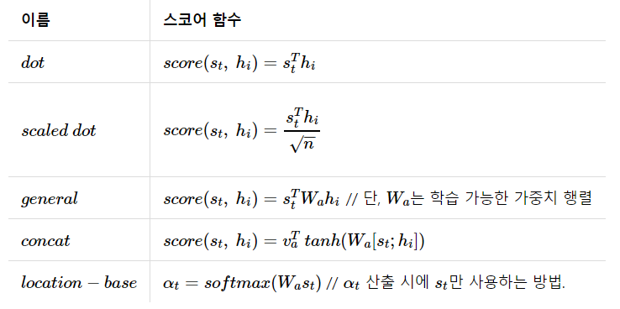
Step.1 – Evaluate Attention Score

Slide 8
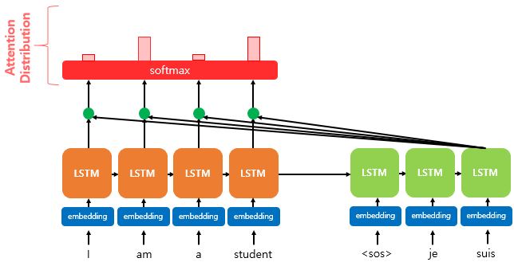
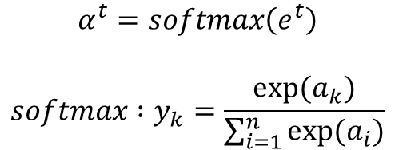
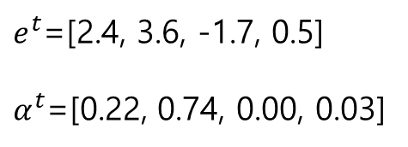
Step.2 – Evaluate Attention Distribution
$e^{t}$=[2.4, 3.6, -1.7, 0.5]
$α^{t}$=[0.22, 0.74, 0.00, 0.03]
$$α^{t}=softmax\left(e^{t}\right)$$
$$softmax :y_{k}=\frac{exp(a_{k})}{\sum_{i=1}^{n}{exp(a_{i})⁡}}$$

Slide 9
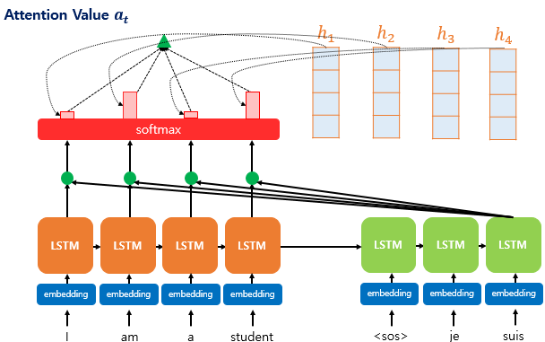
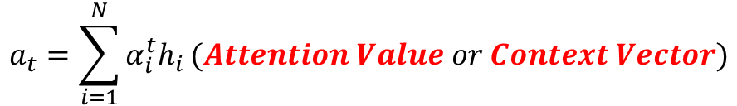
Step.3 – Evaluate Attention Value
$$a_{t}=\sum_{i=1}^{N}{α_{i}^{t}h_{i}}(Attention Value or Context Vector)$$

Slide 10
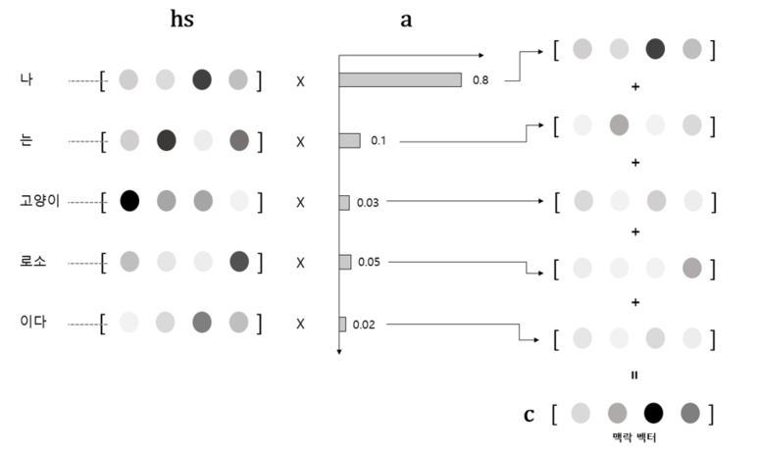
Step.3 – Evaluate Attention Value

Slide 11
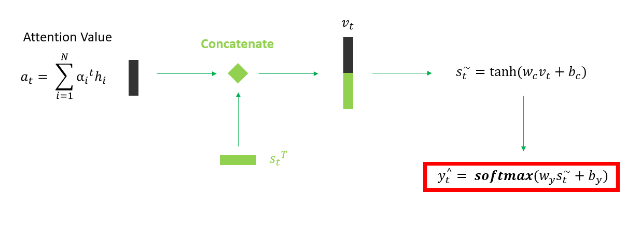
Step.4 – Evaluate New hidden State and Output
Feedforward Neural Network
$v_{t}$: Concatenation of Attention Value($a_{t}$) and Hidden State of Decoder($s_{t}$)

Slide 12
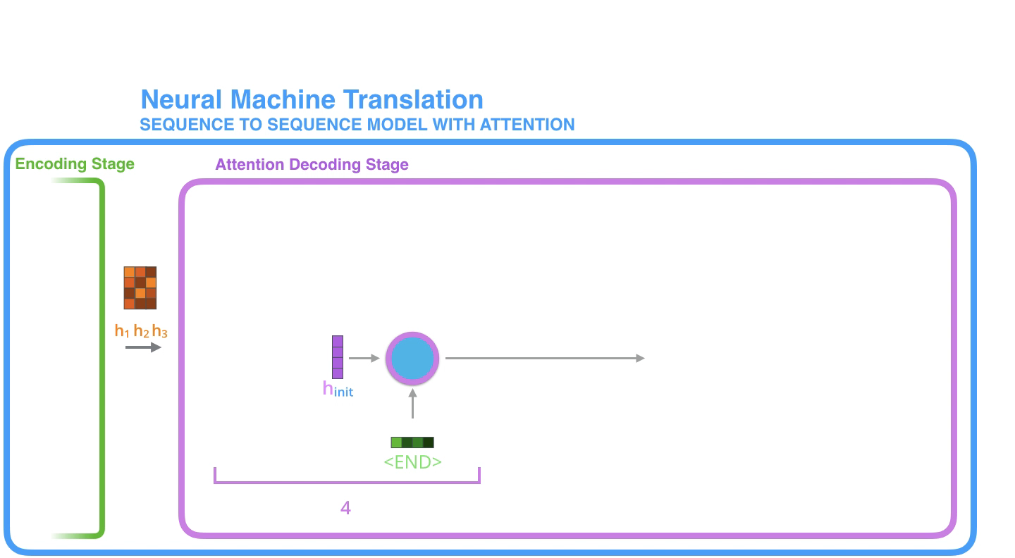
Summary

Slide 13
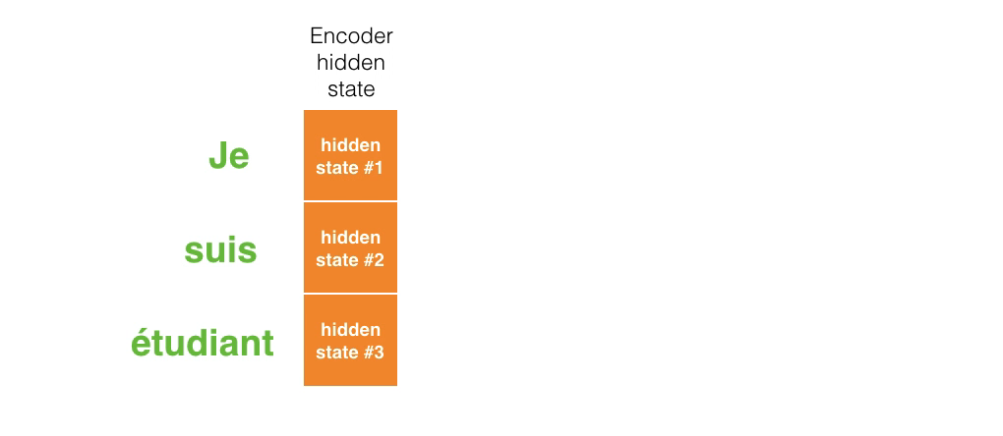
Summary

Slide 14
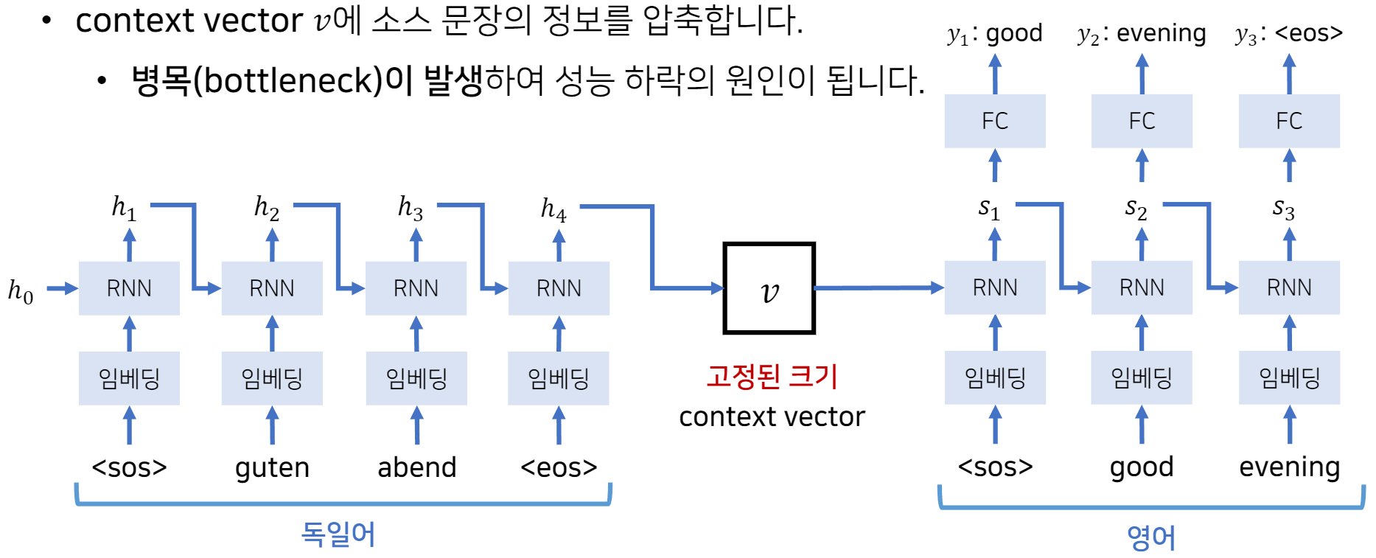
seq2seq vs seq2seq with attention
Weight Vector
W.S
Attention Value(Context Vector)
Hidden State of Encoder
✚

Slide 15
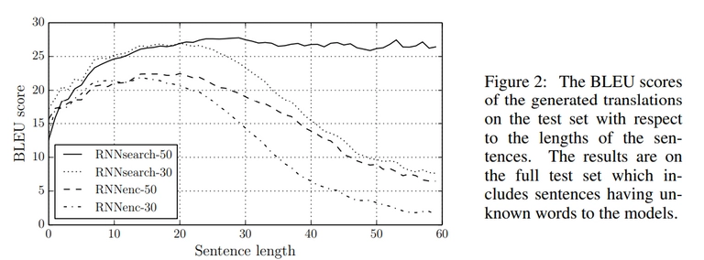
Result

Slide 16
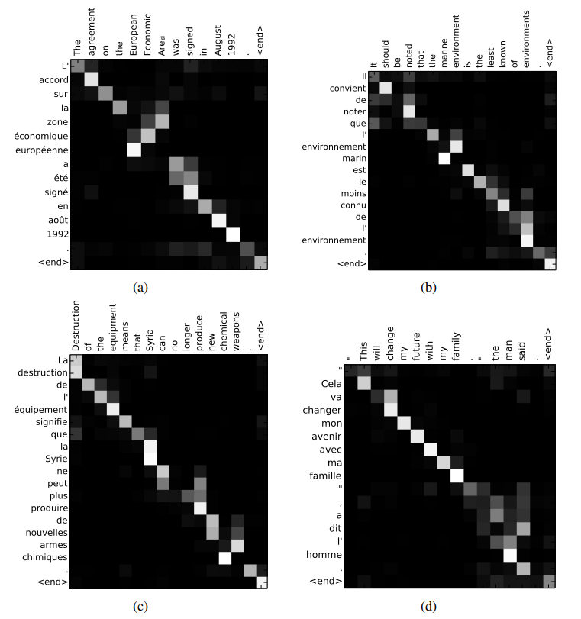
Result - Qualitative Analysis

